Slide 1
Career4ISers
Yue Chen
Ruoyi Li
Ibrahim Shakeel
Lijun Yang
Yangbin Zhou
BUDT758Y-0503 Group08
12/02/2018

Slide 2
Background
Users:
Students who will have active profiles, and will search the database for jobs and events.
Administrators who will routinely update the database with new job and event information.

Slide 3
Background
Data Sources:
We have used four websites for data population in our database:
www.indeed.com – An American based search engine for job listings
www.careerbuilder.com – CareerBuilder is also an online employment website
www.glassdoor.com – A website where employees and former employees anonymously review companies and management
www.umd-csm.symplicity.com – Website contains information that helps students connect with institutions and potential employers

Slide 4
Mission Statement & Objective
Mission Statement:
We intend to create a database system that will not only optimally maintain records for all IS internships and opportunities, but will also provide students up-to-date results for all job, internship, and event inquiries.
Mission Objective:
The database will maintain records of students register information and allow students to search internships, jobs and events; the recorded job data will also include source data (i.e. company name, source of post). The database will also maintain students job search and event search records.

Slide 5
Business Functions
Maintain records of all students enrolled with Career4ISers systems.
Maintain records of all job posts, events posts, company and source.
Provide jobs, internship opportunities and events listings to students.
Allow students to search active jobs, internship and events posts.
Maintain students job search and event search records.

Slide 6
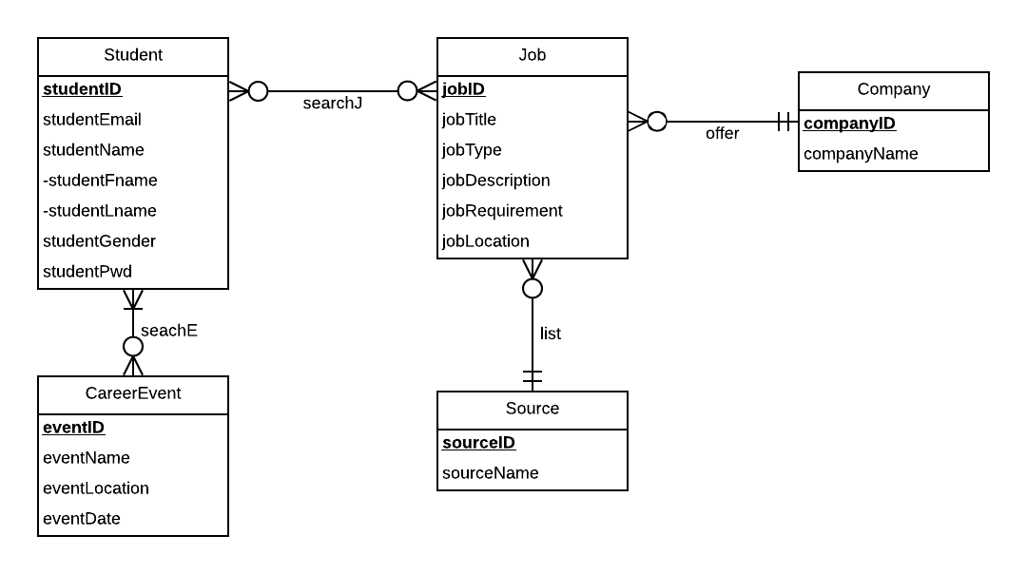
ER diagram

Slide 7
Relational Schema
Job(jobId, jobTitle, jobType, jobDescription,jobRequirement, jobLocation, sourceId, companyId)
Student(studentId, studentEmail,studentFname, studentLname, studentGender, studentPsw)
Company(companyId,companyName)
CareerEvent(eventId, eventName,eventLocation, eventDate)
Source(sourceId,sourceName)
SearchJ(studentId, jobId)
SearchE(studentId, eventId)

Slide 8
Physical Database Design
CREATE TABLE Job(
jobId VARCHAR(5) NOT NULL,
jobTitle VARCHAR(100) NOT NULL,
jobType VARCHAR(20) NOT NULL,
jobDescription VARCHAR(800),
jobRequirement VARCHAR(500),
jobLocation VARCHAR(100),
sourceId VARCHAR(3) NOT NULL,
companyId VARCHAR(5) NOT NULL,
CONSTRAINT pk_Job_jobId PRIMARY KEY (jobId),
CONSTRAINT fk_Job_sourceId FOREIGN KEY (sourceId) REFERENCES Source (sourceId) ON DELETE CASCADE ON UPDATE CASCADE,
CONSTRAINT fk_Job_companyId FOREIGN KEY (companyId) REFERENCES Company (companyId) ON DELETE CASCADE ON UPDATE CASCADE
);

Slide 9
Use Cases: Job List
What is the job information for all the posted jobs?
SELECT j.jobTitle, j.jobType, j.jobDescription, j.jobRequirement, j.jobLocation, c.companyName, s.sourceName
FROM Job j, Company c, Source s
WHERE j.companyId = c.companyId AND j.sourceId = s.sourceId;

Slide 10
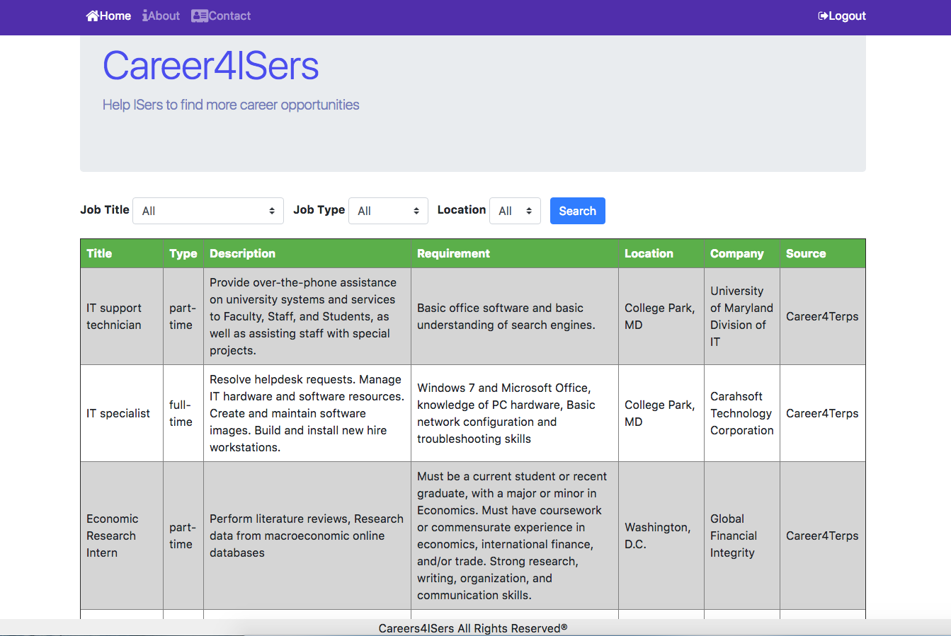
Use Cases: What is the job information for the posted jobs?

Slide 11
Use Cases: List Full Time Jobs
What is the detailed information for all ‘full-time’ jobs?
SELECT j.jobTitle, j.jobType, j.jobDescription, j.jobRequirement, j.jobLocation, c.companyName, s.sourceName
FROM Job j, Company c, Source s
WHERE j.companyId = c.companyId AND j.sourceId = s.sourceId AND j.jobType = ‘full-time’;

Slide 12
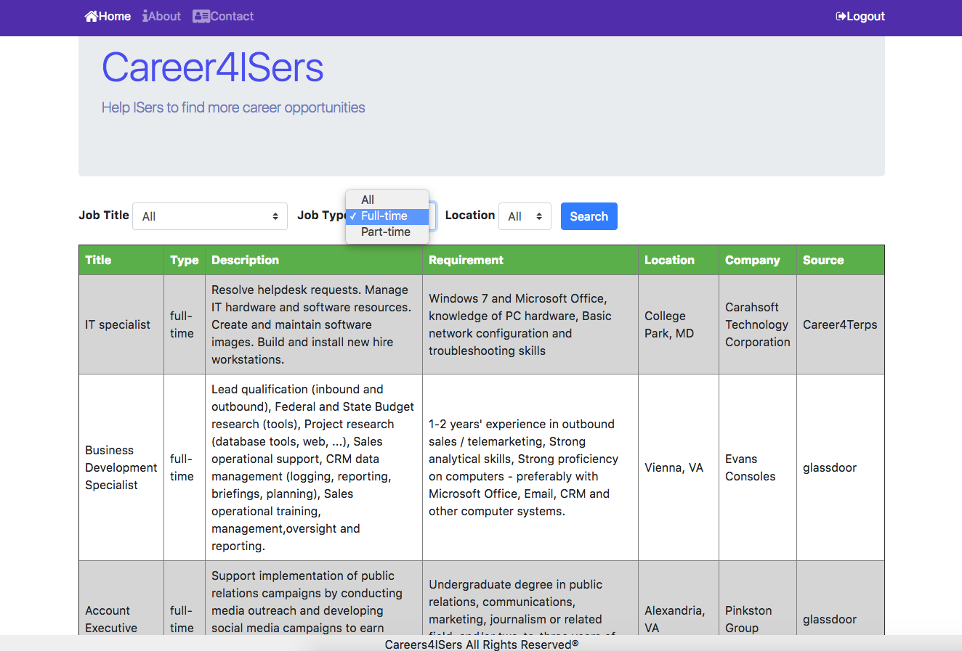
Use Cases: What is the information for ‘full-time’ jobs?

Slide 13
Use Cases: List Data Scientist Jobs
What is the detail information for the jobs with title “Data Scientist” ?
SELECT j.jobTitle, j.jobType, j.jobDescription, j.jobRequirement, j.jobLocation, c.companyName, s.sourceName
FROM Job j, Company c, Source s
WHERE j.companyId = c.companyId AND j.sourceId = s.sourceId AND j.jobTitle = ‘Data Scientist’;

Slide 14
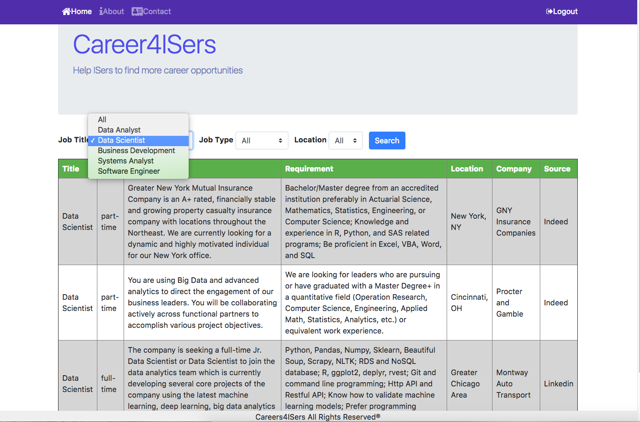

Use Cases: What is the Job detail with title ‘Data Scientist’

Slide 15
Use Cases: List Career Events
What is the information of posted career events?
SELECT eventName, eventLocation, eventDate
FROM CareerEvent;

Slide 16
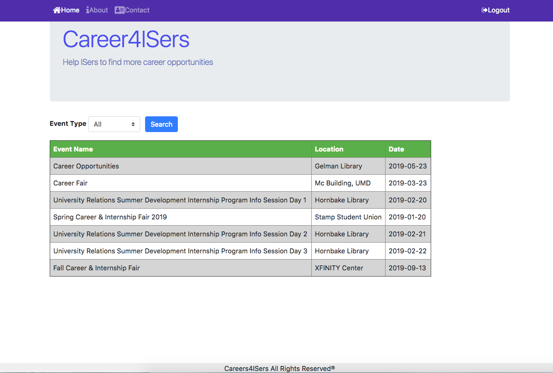
Use Cases: what is the information of posted career events?

Slide 17
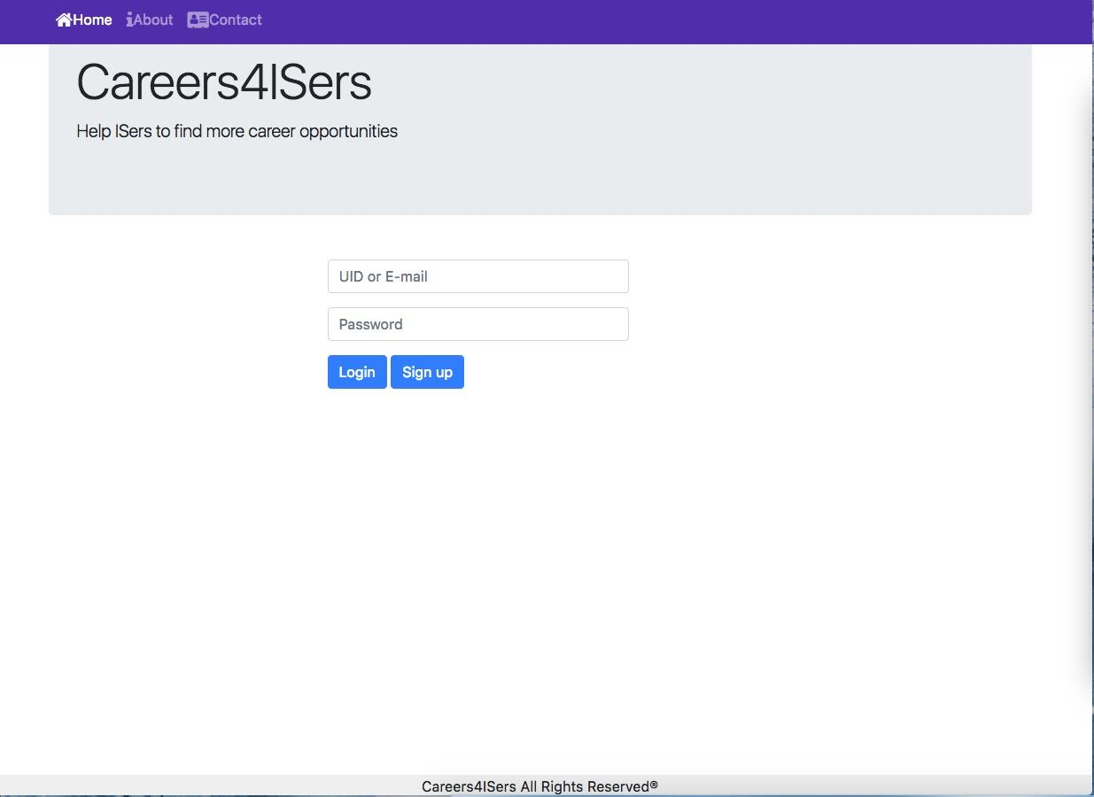
Application: Log In

Slide 18
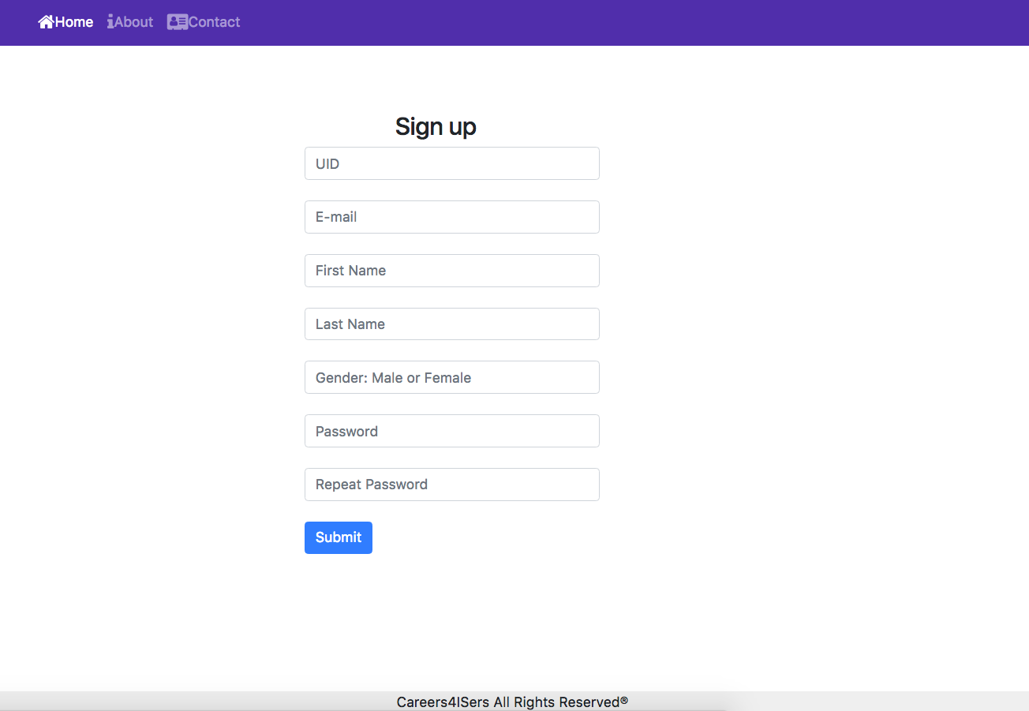
Application: Sign Up

Slide 19
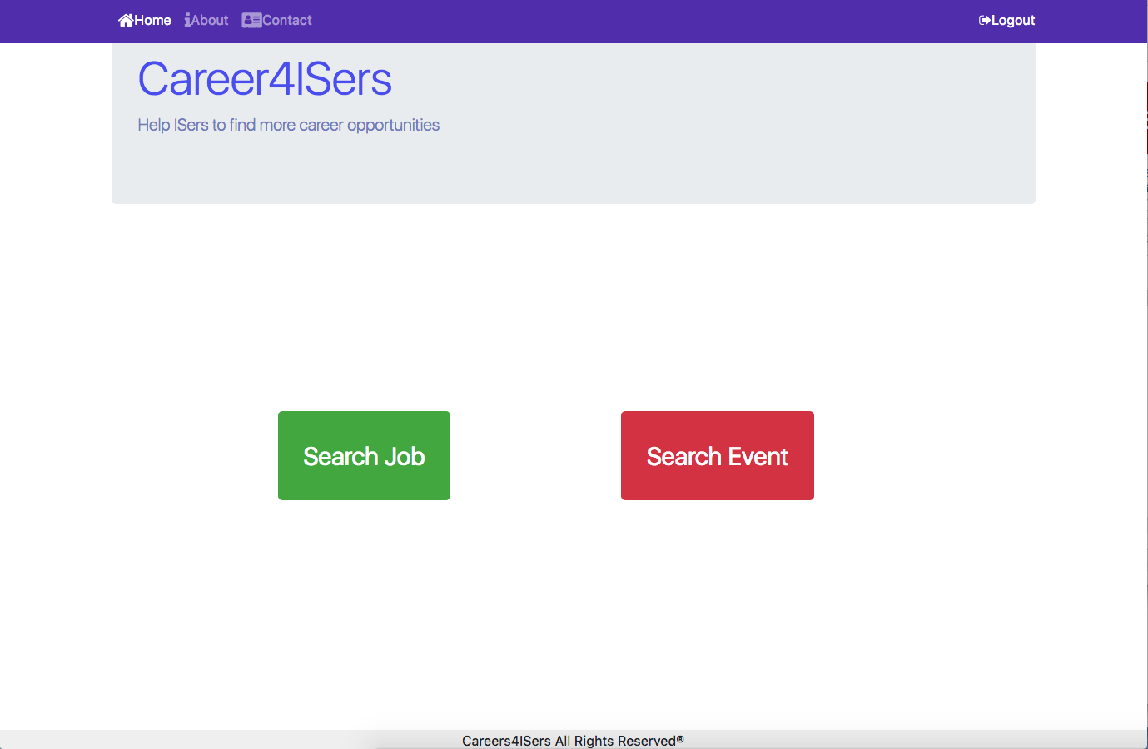
Application: Search Job or Search Event

Slide 20
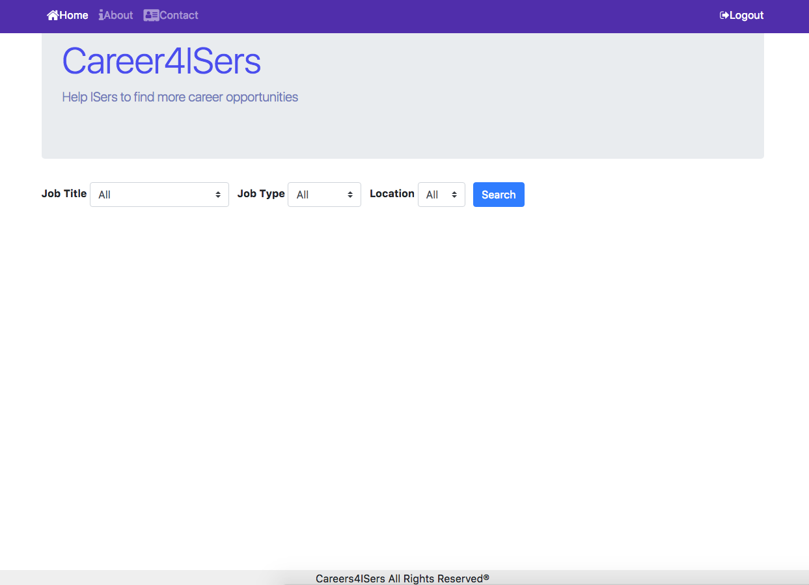
Application: Search Job Interface

Slide 21
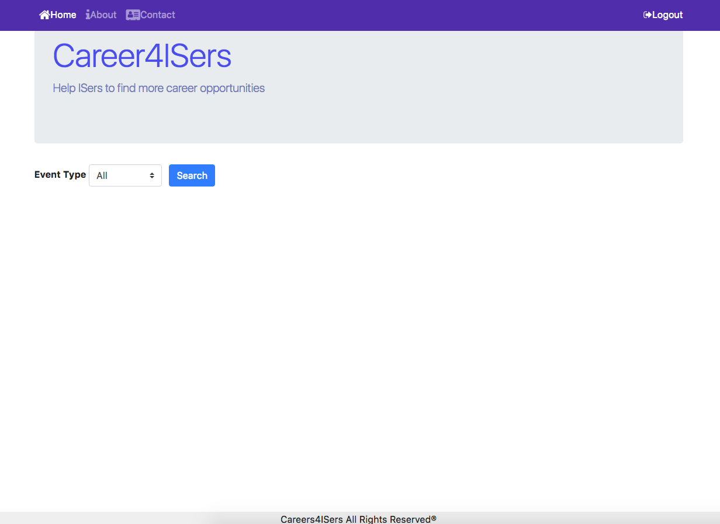
Application: Search Event Interface

